Slide 1

MTECH AAI COHORT-1 Dissertation Project – Phase II
Evaluation-I
Presented by: Sanjeev Kumar Pandey
Enrolment No: MT23AAI001
Project Guide: Dr. Amit Agrawal

Slide 2
Human ID & Activity Prediction using Wi-Fi Signals
Leveraging Wi-Fi Channel State Information (CSI) and RSSI
Sanjeev Kumar Pandey | 10-Sep-2025

Slide 3
Project Objectives
Dataset Aim: Wi-Fi-based Human Activity Recognition (HAR) in indoor environments (LOS & NLOS).
Objective 1: Detect the activity action type from Wi-Fi signals.
Objective 2: Detect the ID of the person performing the activity.

Slide 4
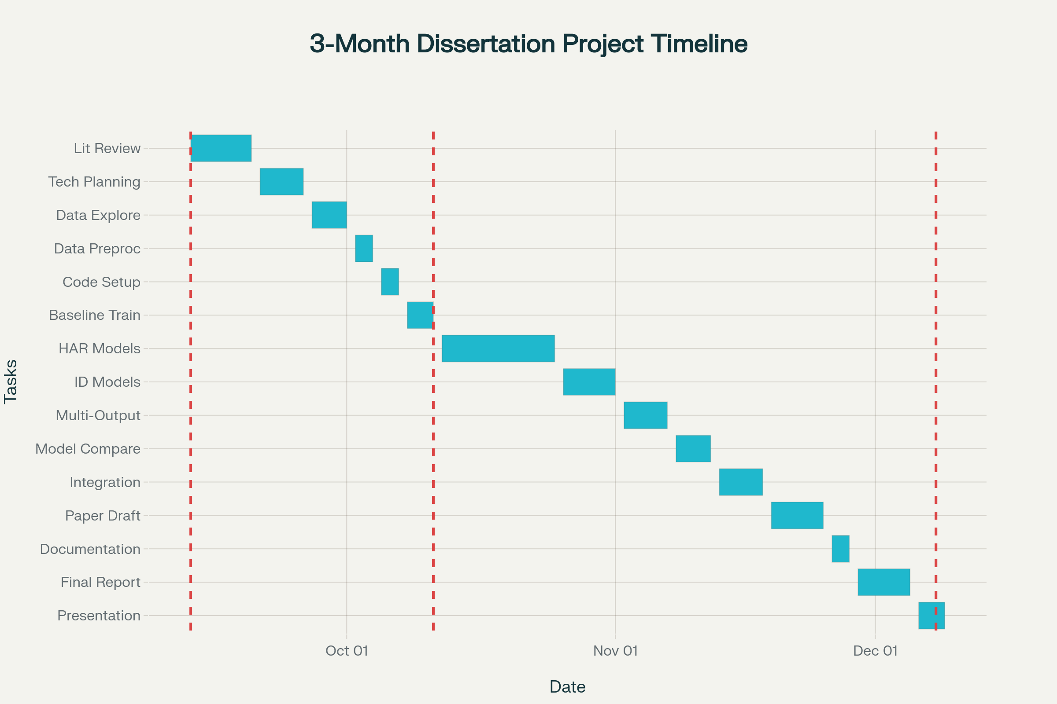

Slide 5
Planning overview
Literature Review & Planning: Start with reading key papers, setting objectives, and technical planning.
Data Understanding & Preprocessing: Explore dataset, feature extraction, and handle CSI/RSSI preprocessing.
Initial Coding & Baseline Model (Eval 1): Set up coding, implement baseline models, run initial training and evaluation.
Advanced Model Training & Experimentation (Eval 2): Design and train advanced models (HAR, Human ID, multi-output), experiment, and tune.
Analysis & Integration: Compare results, integrate best-performing models, and conduct error analysis.
Research Paper Drafting & Documentation: Start documentation and research paper draft, plus slides for presentation.
Final Report & Presentation (Eval 3): Polish final report, prepare for oral defense, and respond to committee feedback.

Slide 6
Dataset Overview
Source Paper: 'A dataset for Wi-Fi-based human activity recognition in LOS and NLOS indoor environments'. https://pmc.ncbi.nlm.nih.gov/articles/PMC7704290/pdf/main.pdf
Authors: Baha’ A Alsaify et al., Jordan University of Science and Technology, German Jordanian University.
Publication Date: November 18, 2020.
Purpose: Benchmark dataset for HAR research across LOS & NLOS settings.

Slide 7
Key Features of Dataset
Participants: 30 subjects (28 male, 2 female), age ~22.7 ± 2.95 years.
Activities: 12 unique actions across 5 experiment classes.
Environments: 2 LOS (lab, hallway) + 1 NLOS (wooden wall barrier).
Data Types: Channel State Information (CSI) and RSSI values.
File Naming: Ex_Sy_Cz_Ai_Tk.csv (e.g., E1_S04_C3_A7_T17.csv).

Slide 8
Feasibility of Human ID Prediction
Subject ID explicitly labeled in filenames (S1–S30).
Biometric info (age, weight, height) subtly affects signals.
CSI & RSSI are sensitive to individual movement signatures.
Rich dataset (3000 trials) suitable for Human ID modeling.

Slide 9
Use Case: Security & Monitoring
Traditional biometrics (faces, fingerprints) can be spoofed & require active participation.
Wi-Fi-based ID is passive, non-intrusive, and works in NLOS environments.
Applications: High-security zones (ISRO, NASA, Parliament House), covert surveillance, medical alerts.

Slide 10
Target Variables
HAR Activity Recognition: Classify 12 unique activities (A1–A12).
Human ID: Identify 1 of 30 subjects (S1–S30).
Input Data: CSI & RSSI values sensitive to presence & movement.

Slide 11
Model Development Approaches
Approach 1: Two Separate Models
HAR Activity Classifier (12 classes).
Human ID Classifier (30 subjects).
Approach 2: One Multi-Output Model
Single model with shared features.
Two output heads: Activity & ID.

Slide 12
Conclusion & Next Steps
Dataset provides rich labeled Wi-Fi signal data (CSI, RSSI).
Suitable for both HAR and Human ID tasks.
Choice: Separate models (simplicity) vs. Multi-output model (efficiency).
Next Step: Implement and evaluate both approaches.

Slide 13
MTECH AAI COHORT-1 Dissertation Project – Phase II
Evaluation-II
Presented by: Sanjeev Kumar Pandey
Enrolment No: MT23AAI001
Project Guide: Dr. Amit Agrawal
Date: 11-Oct-2025

Slide 14
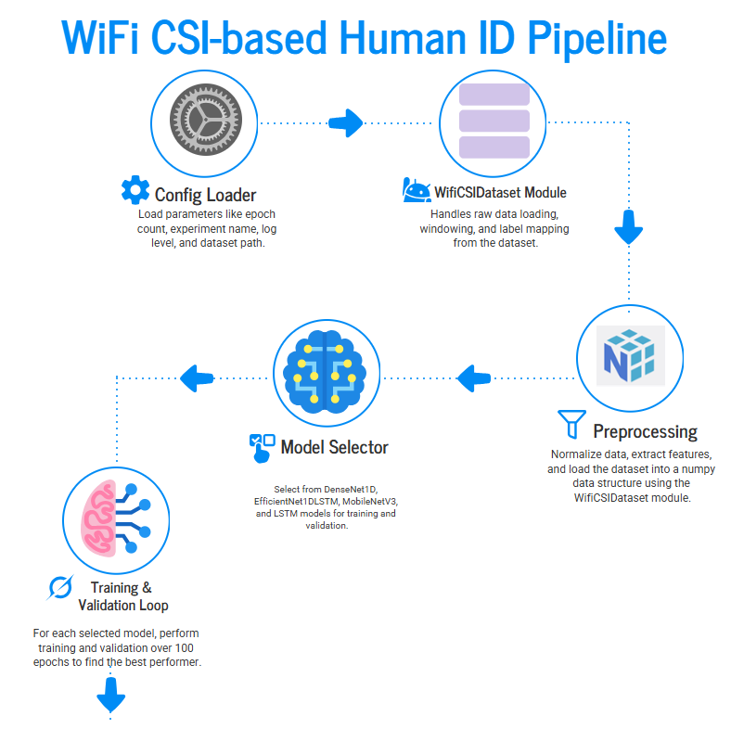

Slide 15
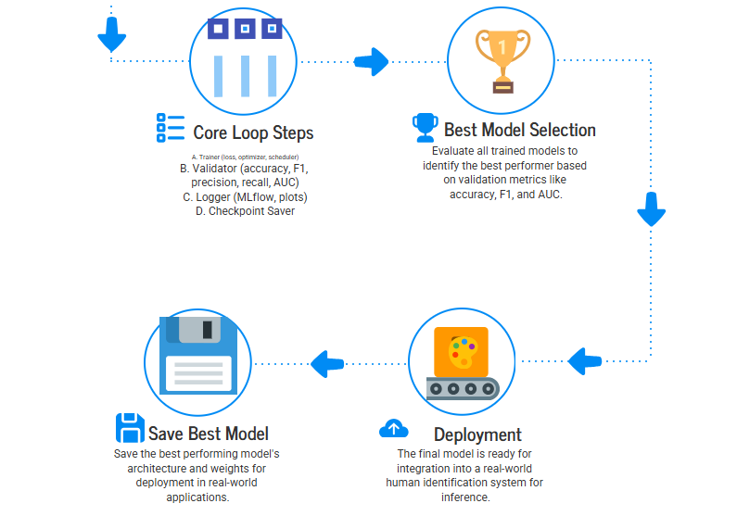

Slide 16
Project Objective
The project performs a comparative study across four distinct DL architectures, all designed to process both the time-series CSI sequence and the auxiliary metadata sequence simultaneously.
Model Name | CSI Processing Core | Metadata Processing Core | Key Features
CSILSTMNet | Standard LSTM | Standard LSTM | Uses the last hidden state from two parallel LSTMs (one for CSI, one for Meta).
DenseNet1D | Dense Block 1D CNN | Bidirectional LSTM | Uses 1D CNN blocks (DenseBlock1D) followed by global pooling for CSI, combined with a Bi-LSTM for metadata.
EfficientNet1DLSTM | MBConv1D Blocks | Bidirectional LSTM | Leverages Mobile Inverted Bottleneck (MBConv) blocks (stem, mbconv1-3) designed for efficiency, combined with a Bi-LSTM.
MobileNetV3_1D_LSTM | MobileNetV3 Block 1D | Bidirectional LSTM | Incorporates specialized blocks (including depthwise separable convolutions and Squeeze-and-Excitation (SE) layers) optimized for mobile/efficient computing, combined with a Bi-LSTM.

Slide 17
MLflow Integration
Feature Focus: Seamless integration with MLflow for experiment tracking and performance comparison.
What It Does:
Automatically logs training runs for all four models — DenseNet1D, EfficientNet1DLSTM, MobileNetV3_1D_LSTM, and LSTM.
Captures hyperparameters, metrics (Accuracy, F1, Precision, Recall, AUC), and loss curves per epoch.
Why It Matters:
Enables side-by-side model comparison through MLflow dashboards and visual graphs.
Ensures reproducibility and transparency of experiments.
Simplifies identification of the best-performing model over 100 epochs.
Outcome: Data-driven insights for model selection and performance optimization.

Slide 18

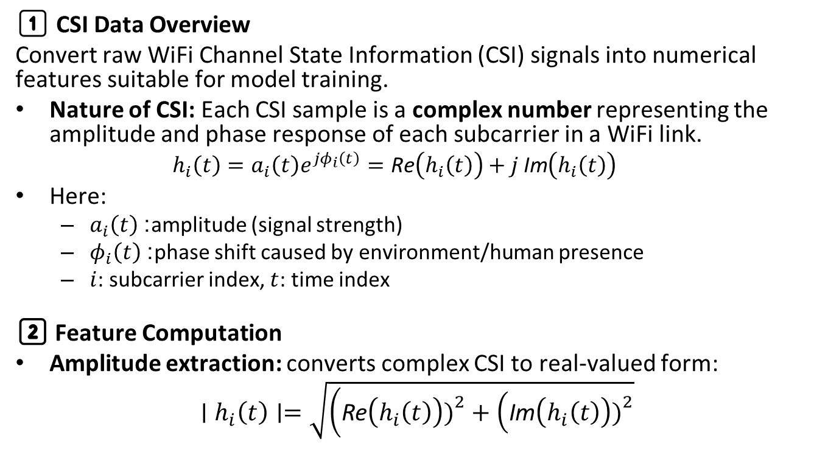
CSI Data
1️⃣ CSI Data Overview
Convert raw WiFi Channel State Information (CSI) signals into numerical features suitable for model training.
Nature of CSI: Each CSI sample is a complex number representing the amplitude and phase response of each subcarrier in a WiFi link.
$$h_{i}\left(t\right)=a_{i}\left(t\right)e^{jφ_{i}\left(t\right)}=\text{Re}\left(h_{i}\left(t\right)\right)+j \text{Im}\left(h_{i}\left(t\right)\right)$$
Here:
$a_{i}\left(t\right)$: amplitude (signal strength)
$φ_{i}\left(t\right)$: phase shift caused by environment/human presence
$i$: subcarrier index, $t$: time index
2️⃣ Feature Computation
Amplitude extraction: converts complex CSI to real-valued form:
$$∣h_{i}\left(t\right)∣=\sqrt{\left(\text{Re}\left(h_{i}\left(t\right)\right){\left.)\right.}^{2}+\left(\text{Im}\left(h_{i}\left(t\right)\right){\left.)\right.}^{2}\right.\right.}$$

Slide 19
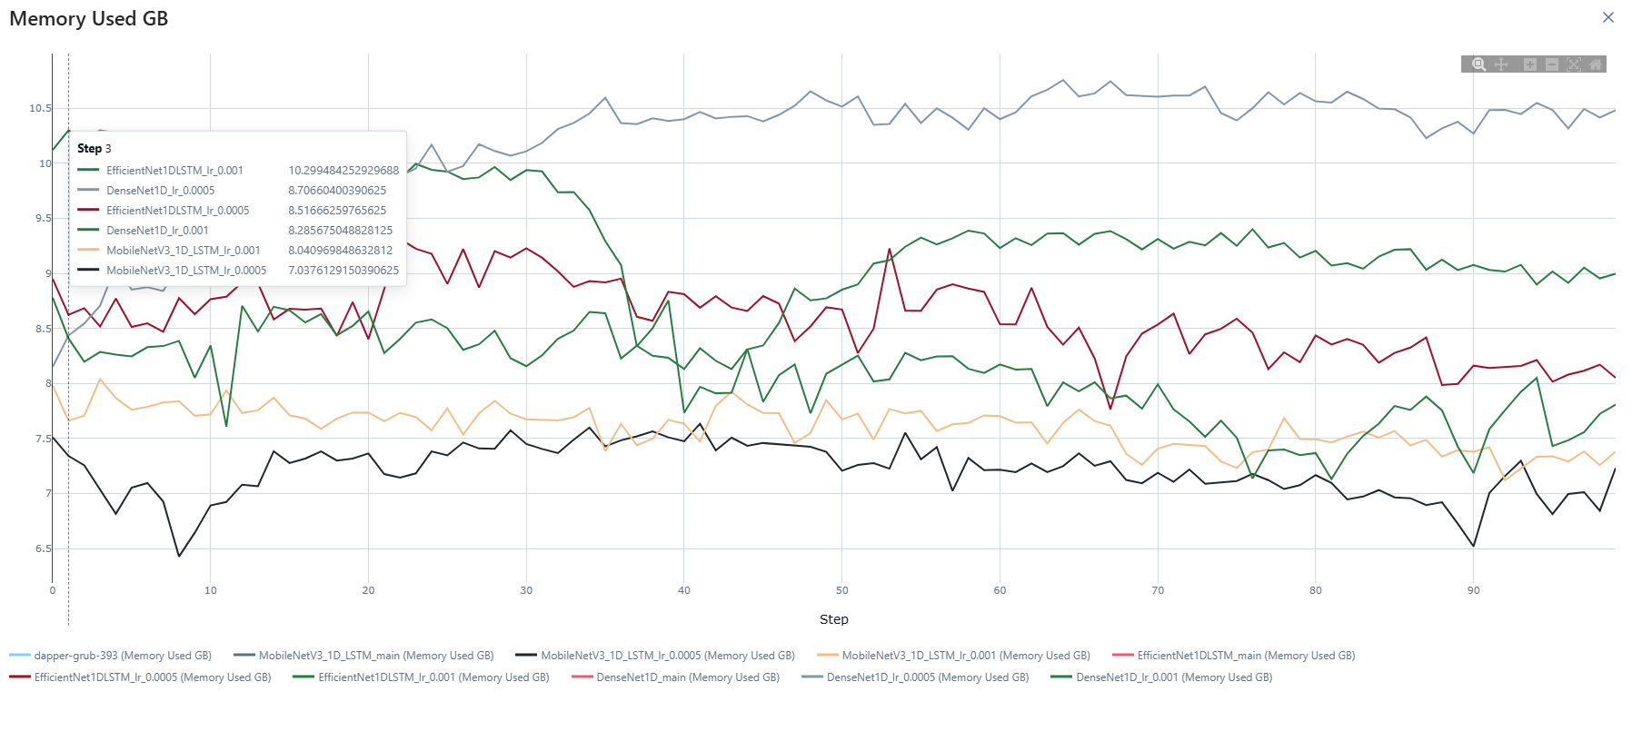

Slide 20
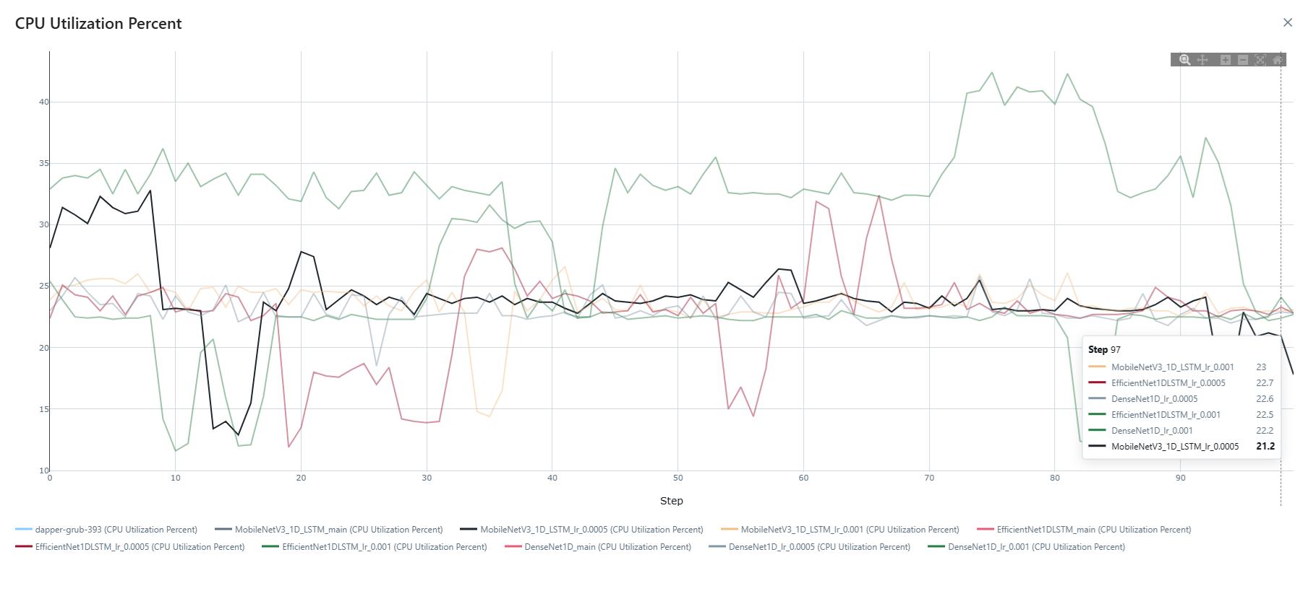

Slide 21
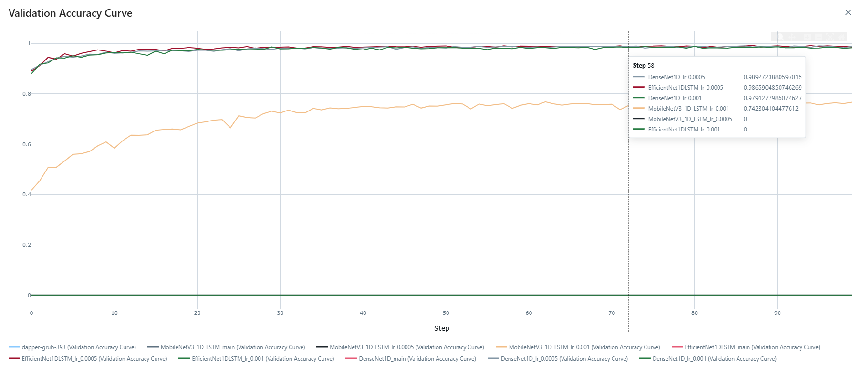

Slide 22
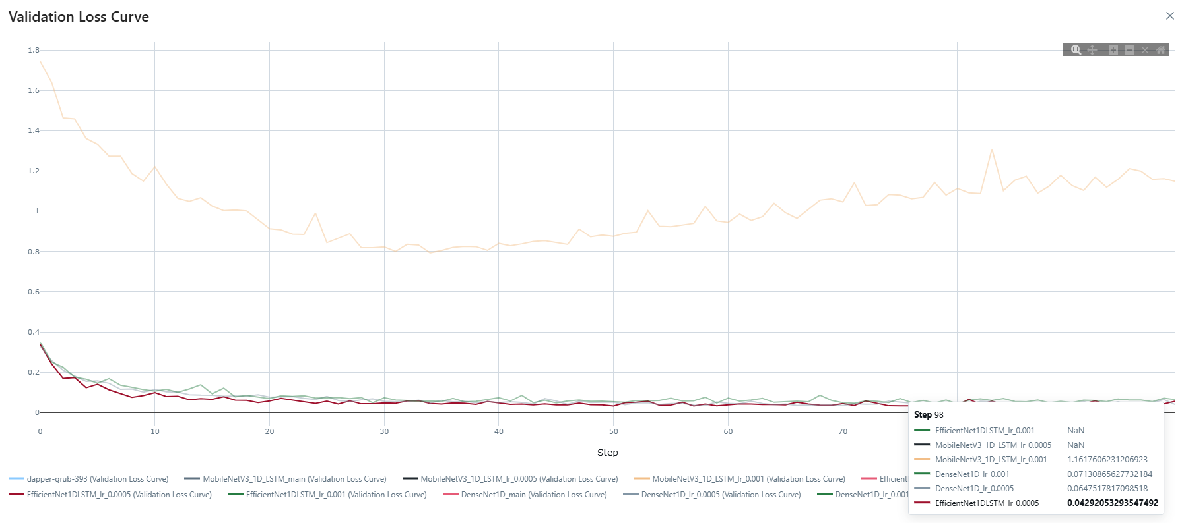

Slide 23
Best Model
Model Performance Comparison
Objective: Evaluate four DL models on experiment data using two learning rates (0.001, 0.0005)
Top Performing Models:
DenseNet1D (lr=0.0005): Best overall metrics
EfficientNet1DLSTM (lr=0.0005): High, consistent metrics
CSILSTMNet (lr=0.0005, 0.001): Slightly below leaders
MobileNetV3_1D_LSTM (lr=0.001): Lower but strong metrics
Model | Learning Rate | Best Validation Accuracy | Best Validation Precision | Best Validation Recall | Best Validation F1 Score
DenseNet1D | 0.0005 | 0.999938 | 0.999938 | 0.999938 | 0.999938
EfficientNet1DLSTM | 0.0005 | 0.99993 | 0.99993 | 0.99993 | 0.99993
DenseNet1D | 0.001 | 0.999904 | 0.999904 | 0.999904 | 0.999904
CSILSTMNet | 0.0005 | 0.999826 | 0.999826 | 0.999826 | 0.999826
CSILSTMNet | 0.001 | 0.999814 | 0.999814 | 0.999814 | 0.999814
MobileNetV3_1D_LSTM | 0.001 | 0.988529 | 0.988529 | 0.988529 | 0.988529

Slide 24
Insights & Conclusions
Learning Rate Tuning: Lower learning rate (0.0005) consistently outperforms 0.001 for all models
Metric Trends: Metrics (accuracy, precision, recall, F1) closely match for each model configuration, indicating balanced performance
Best Model: DenseNet1D with lr=0.0005 is the optimal choice for this experimental dataset
Generalization: High and consistent validation scores suggest good model generalization and minimal overfitting issues across the experiments​

Slide 25
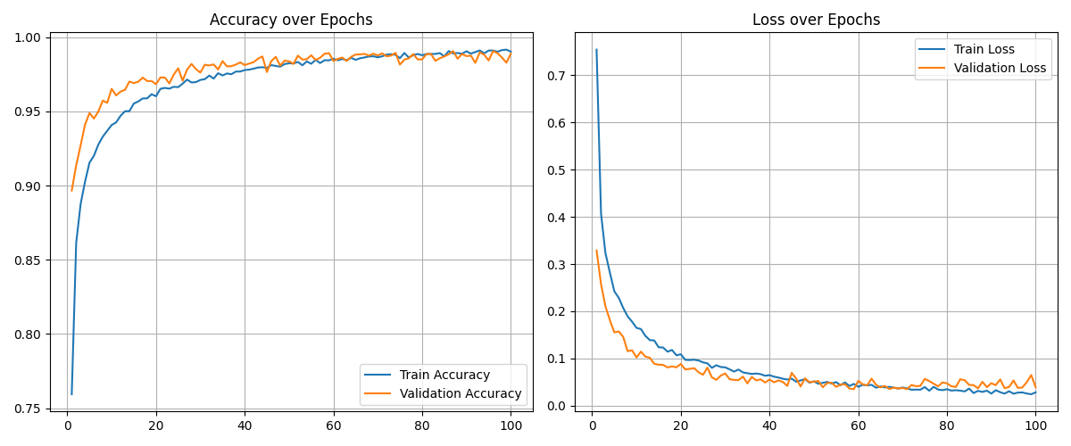
DenseNet1D with lr=0.0005 Plot

Slide 26
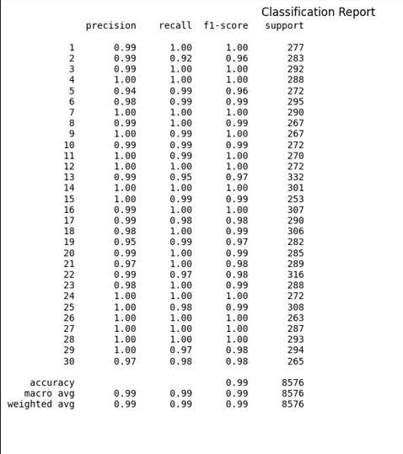
DenseNet1D with lr=0.0005 Plot

Slide 27
Thank you

Slide 28
MTECH AAI COHORT-1 Dissertation Project – Phase II
Evaluation-II
Presented by: Sanjeev Kumar Pandey
Enrolment No: MT23AAI001
Project Guide: Dr. Amit Agrawal
Date: 11-Oct-2025

Slide 29
Experiment-1
Model Name | CSI Input Size / Channels | Meta Features | Sequence / Window Size | Output Classes
CSILSTMNet | 99 | 12 | 128 | 31
DenseNet1D | 99 | 12 | — | 31
EfficientNet1DLSTM | 99 | 12 | 128 | 31
MobileNetV3_1D_LSTM | 99 | 12 | — | 31
Hyperparameter | Values Tested
Learning Rate | 0.001, 0.0005
Batch Size | 16, 32, 64, 128
Optimizer | Adam, SGD
Weight Decay | 0.0, 1e-5, 1e-4, 1e-3
Epochs | 10

Slide 30
Observations from Short-Epoch Grid Search (10 Epochs)
📈 Overall Correlation
Train F1 ↔ Val F1 correlation ≈ 0.88 → Stable training trends
Overfitting visible at higher learning rates or zero weight decay
⚙️ Batch Size
128 (Adam or SGD) under-utilizes gradient noise
Poor early generalization — remove for long (50/100 epoch) runs
📉 Weight Decay
> 1e-3 consistently degrades validation performance
Recommended: 1e-5 – 1e-4
🚀 Learning Rate
0.0005 – 0.001 works best for Adam
SGD needs ≥ 0.005
🧩 Optimizer Behaviour
Adam (no decay) → mild overfitting (Train F1 − Val F1 > 0.05)
Use small decay (1e-4) for better generalization
Conclusion: Restrict long-run grid(50-100 Epochs) to LR ∈ [0.0005–0.001], Batch Size ∈ [32–64], Adam with 1e-4 decay.

Slide 31
ML Training & Validation Summary
Best Performing Model & Hyperparameters
Model: MobileNetV3_1D_LSTM
Val Accuracy: 0.9876
Val F1: 0.9876
Hyperparameters:
Learning Rate: 0.0005
Batch Size: 64
Optimizer: Adam
Weight Decay: 1e-05
Epochs: 10
⚠️Combinations That Did Not Work
Many runs with:
Batch Size = 128
SGD optimizer, or Adam with LR 0.001
Weight Decay ≥ 0.001 or exactly zero
Models: EfficientNet1DLSTM, CSILSTMNet, DenseNet1D, MobileNetV3_1D_LSTM yielded Val Accuracy and Val F1 close to 0 or under 0.70.
Especially for EfficientNet1DLSTM, MobileNetV3_1D_LSTM, and CSILSTMNet, SGD and high batch size failed to generalize, leading to under-utilization of gradient noise.
Other High Performers:
MobileNetV3_1D_LSTM
(LR=0.0005, BS=32, Adam, WD=1e-05)
Val Accuracy: 0.9833
DenseNet1D
(LR=0.0005, BS=64, Adam, WD=0.0)
Val Accuracy: 0.9746
EfficientNet1DLSTM
(LR=0.0005, BS=32, Adam, WD=1e-05)
Val Accuracy: 0.9729
Slide Takeaways:
MobileNetV3_1D_LSTM with LR=0.0005, Batch Size=64, Adam, WD=1e-05 gave the best validation metrics.
DenseNet1D and EfficientNet1DLSTM performed well at lower learning rates and smaller batch sizes with Adam optimizer.
Avoid config: Batch Size 128, SGD, or LR=0.001 with Adam (caused low/zero accuracy for all models).
For future long epoch runs (≥50), focus on: LR ∈ [0.0005, 0.001], **Batch Size ∈ **, Adam optimizer, and weight decay 1e-4 or 1e-5.

Slide 32
Experiment-2
Model Name | CSI Input Size / Channels | Meta Features | Sequence / Window Size | Output Classes
CSILSTMNet | 99 | 12 | 128 | 31
DenseNet1D | 99 | 12 | — | 31
EfficientNet1DLSTM | 99 | 12 | 128 | 31
MobileNetV3_1D_LSTM | 99 | 12 | — | 31
Hyperparameter | Values Tested
Learning Rate | 0.001, 0.0005
Batch Size | 32, 64
Optimizer | Adam
Weight Decay | 1e-4
Epochs | 50, 100

Slide 33
ML Model Validation — Performance Analysis
⭐ Best Performing Model & Hyperparameters
Model: DenseNet1D
Val Accuracy: 0.9917
Val F1: 0.9917
Hyperparameters:
Learning Rate: 0.0005
Batch Size: 64
Optimizer: Adam
Weight Decay: 0.0001
Epochs: 100
⚠️ Models & Hyperparameters That Did Not Work -DenseNet1D, EfficientNet1DLSTM, MobileNetV3_1D_LSTM:
LR: 0.001 or 0.0005
Batch Size: 32 or 64
Optimizer: Adam
Weight Decay: 0.0001
Epochs: 50 or 100
Failure observed for EfficientNet1DLSTM and MobileNetV3_1D_LSTM in nearly all tested configurations.
DenseNet1D failed with LR=0.001 and BS=32/64 for short runs.
🔎 Key Insights
Lower LR (0.0005), higher batch size (64), and Adam optimizer significantly boost DenseNet1D performance in extended runs.
Remove or modify configurations that consistently showed near-zero validation accuracy.

Slide 34
Experiment-3
Model Name | CSI Input Size / Channels | Meta Features | Sequence / Window Size | Output Classes
CSILSTMNet | 99 | 12 | 128 | 31
DenseNet1D | 99 | 12 | — | 31
EfficientNet1DLSTM | 99 | 12 | 128 | 31
MobileNetV3_1D_LSTM | 99 | 12 | — | 31
Hyperparameter | Values Tested
Learning Rate | 0.001, 0.0005
Batch Size | 16, 32
Optimizer | Adam
Weight Decay | 1e-4
Epochs | 100

Slide 35
ML Training & Validation Summary
Best Performing Model & Hyperparameters
Model: DenseNet1D
Val Accuracy: 0.984025187
Val F1: 0.984000433
Hyperparameters:
Learning Rate: 0.0005
Batch Size: 16
Optimizer: Adam
Weight Decay: 1e-04
Epochs: 100
⚠️Combinations That Did Not Work
Many runs with:
Batch Size = 32
Optimizer Adam with LR 0.001
Weight Decay = 0.0001
Models: EfficientNet1DLSTM, CSILSTMNet, DenseNet1D, MobileNetV3_1D_LSTM yielded Val Accuracy and Val F1 close to 0 or under 0.70.
Especially for EfficientNet1DLSTM, MobileNetV3_1D_LSTM, and CSILSTMNet high batch size =32 failed to generalize, leading to under-utilization of gradient noise.
Other High Performers:
CSILSTMNet
(LR=0.0005, BS=16, Adam, WD=1e-04)
Val Accuracy: 0.981576493
DenseNet1D
(LR=0.001, BS=16, Adam, WD= 1e-04)
Val Accuracy: 0.979827425
CSILSTMNet
(LR=0.001, BS=16, Adam, WD= 1e-04)
Val Accuracy: 0.979361007
Slide Takeaways:
EfficientNet1DLSTM with LR=[0.001, 0.0005], Batch Size=[16, 32], Adam, WD=1e-04 didn’t worked, i.e. any hyperparameter combo didn’t worked.
(LR=0.0005, BS=16, Adam, WD=1e-04) worked and specially batch size = 16 for any hyper parameter combo gave best results.
DenseNet1D and CSILSTMNet performed well at lower learning rates and smaller batch sizes with Adam optimizer.
Avoid config: Batch Size 32 and LR=0.001 with Adam (caused low/zero accuracy for all models).

Slide 36
Experiment-3
Model Name | CSI Input Size / Channels | Meta Features | Sequence / Window Size | Output Classes
CSILSTMNet | 99 | 12 | 128 | 31
DenseNet1D | 99 | 12 | — | 31
EfficientNet1DLSTM | 99 | 12 | 128 | 31
MobileNetV3_1D_LSTM | 99 | 12 | — | 31
Hyperparameter | Values Tested
Learning Rate | 0.001, 0.0005
Batch Size | 16, 32
Optimizer | Adam
Weight Decay | 1e-4
Epochs | 100

